Slide 1
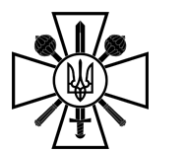
Violations of International Humanitarian Law russia's war crimes
Version 1.0
Notes:
This presentation was prepared by the International Law Section of the Legal Department of the Ukrainian MoD. It must be used during the events of international cooperation, participation in which is approved by the appropriate level commander.
In case of questions on the presentation, comments on the lessons learned of its using or proposal on its improving, kindly ask you to contact us via email ild_ld@mod.gov.ua or by phone (044) 29-36-071.

Slide 2
Agenda
1. russia’s war crimes: scope and types
2. Investigation of IHL violations on the national level
3. Role of the Ukrainian MoD and the Armed Forces in the investigation of IHL violations
4. War crimes investigations on the international level
02

Slide 3
russia’s war crimes
War crimes are grave breaches of the Geneva Conventions of 12 August 1949 and other serious violations of the laws and customs applicable in the armed conflict
Russia commits almost all types of war crimes
Russia’s war crimes are large- scale and systematic
03
Notes:
Armed conflict of the international character between the Russian Federation and Ukraine have started in 2014 with the aggression of the Russian Federation against Ukraine by occupation of the Crimean peninsula and the subsequent occupation of parts of Luhansk and Donetsk regions of Ukraine.
Since that time the Geneva Conventions of 12 August 1949 and other IHL sources are applicable.
On February 24, 2022, the Russian Armed Forces carried out a massive missile attack on many populated areas of Ukraine and launched a large-scale invasion of the territory of Ukraine.
The purpose of Russia's aggression is the erasure of Ukrainian identity, the destruction of Ukrainian statehood, capturing of the territories and population of Ukraine.
By invasion of Ukraine the Russian Federation violated States’ right to resort to force (jus ad bellum). However, set of rules that must be followed during the armed conflict (jus in bello), IHL, is also broadly violated by Russia and its Armed Forces.
Almost all types of war crimes are committed by Russia during the large-scale invasion. They have large scale and systematic nature: are committed all over the territory of Ukraine, by different Russian Armed Forces detachments, lasting from the beginning of the armed conflict.
Short description of the war crimes scope is provided on next slides.

Slide 4
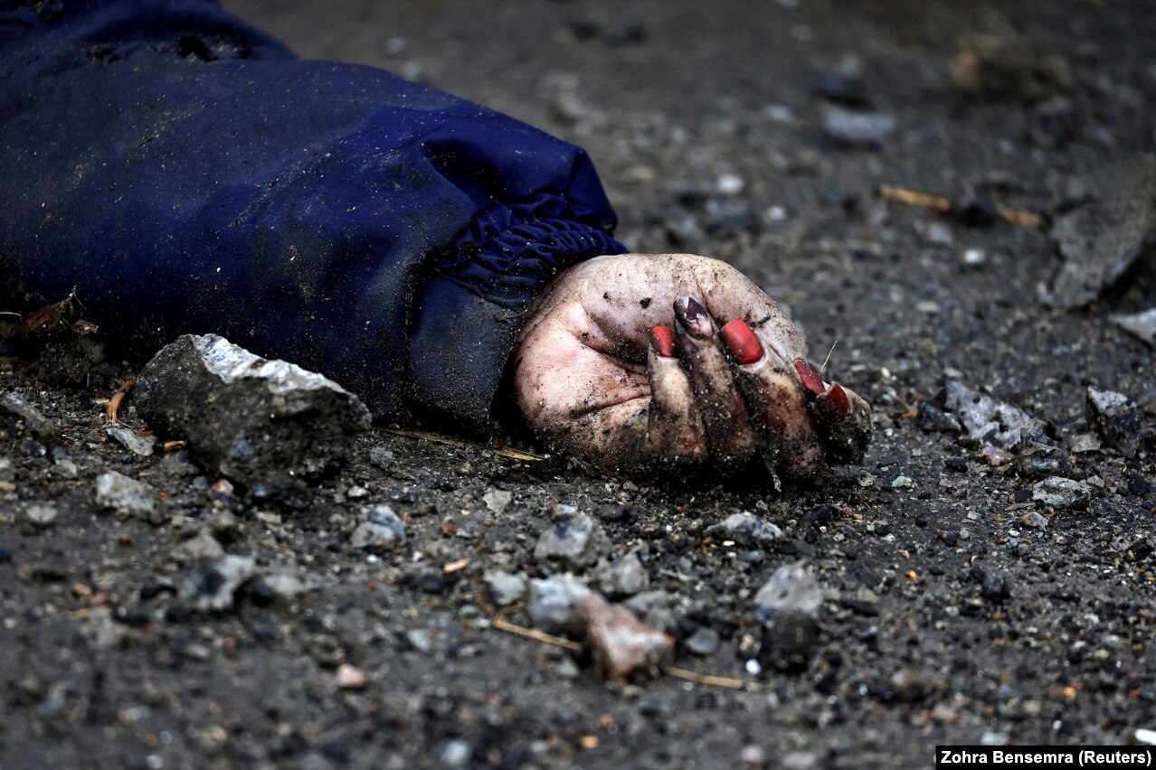
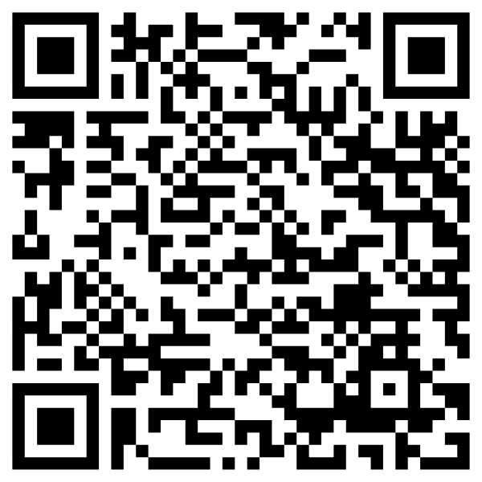
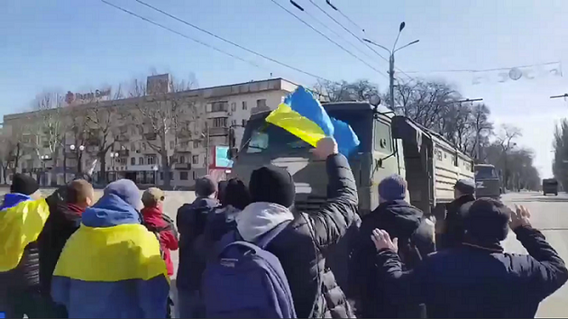
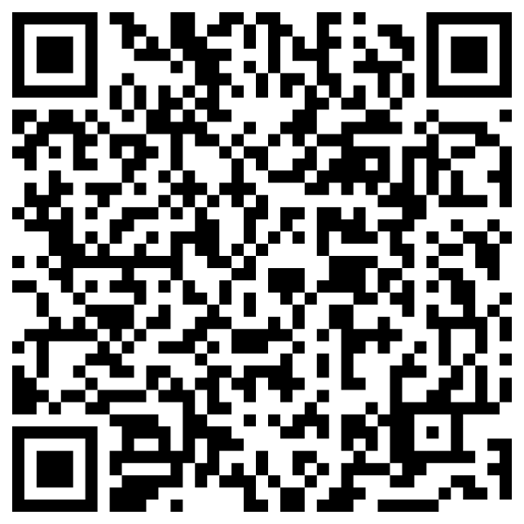
russia’s war crimes
1. Attacks against civilians and civilian population
Dispersal of peaceful
rallies in Kherson
For more see:
Iryna Filkina, a 52-year-old woman, one of the victims of Yablunska street in Bucha. For more see:
04
Notes:
Since the beginning of February 2022 Ukrainian civilians have been massively killed and injured by the hostilities, conducted by the Russian Federation.
Civilians are unlawfully targeted by Russian Armed Forces in different manners:
Intentional murders
Attacks on civilian objects
Tortures and other inhuman treatment
Etc.
1. One of the well known picture of Russias crimes, committed during the temporary occupation of Kyiv region, Bucha. Iryna Filkina, a 52-year-old woman was killed while driving a bike in Bucha, Kyiv region, during the temporary occupation in 2022.
2. Kherson became a symbol of resistance to the Russian occupation in spring 2022. The Russians brutally dispersed peaceful pro-Ukrainian rallies in Kherson and other cities and towns, subjecting the protestors to beatings, mutilations, detention with subsequent torture and extrajudicial killings. Such actions constitute an attack against civilians in the meaning of IHL.

Slide 5
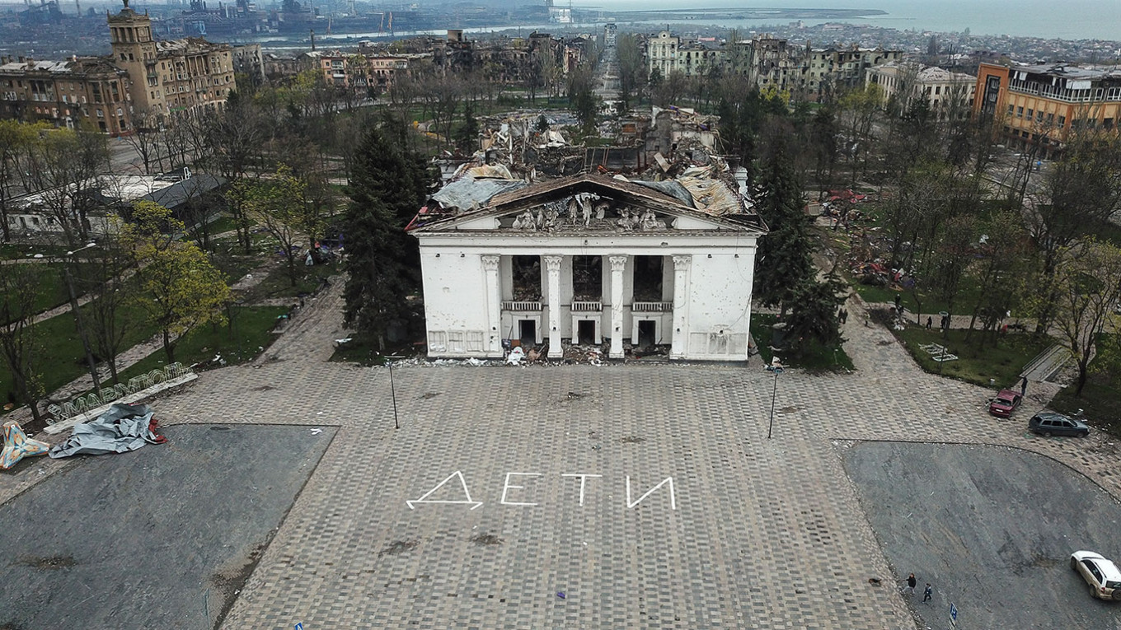
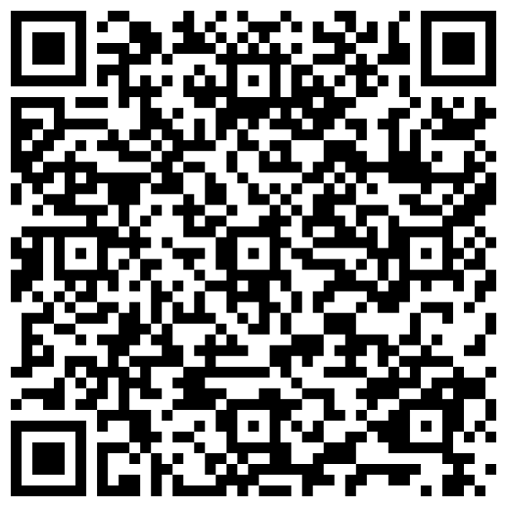
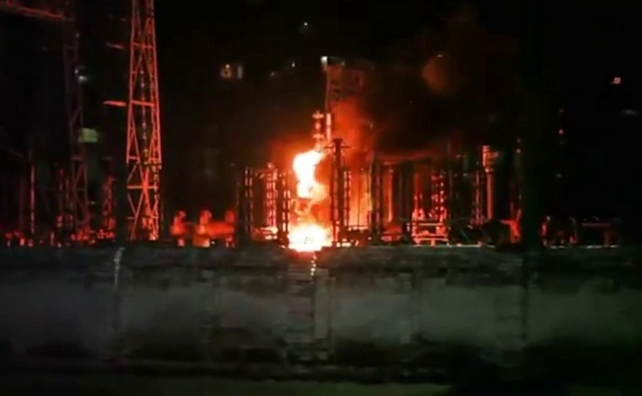
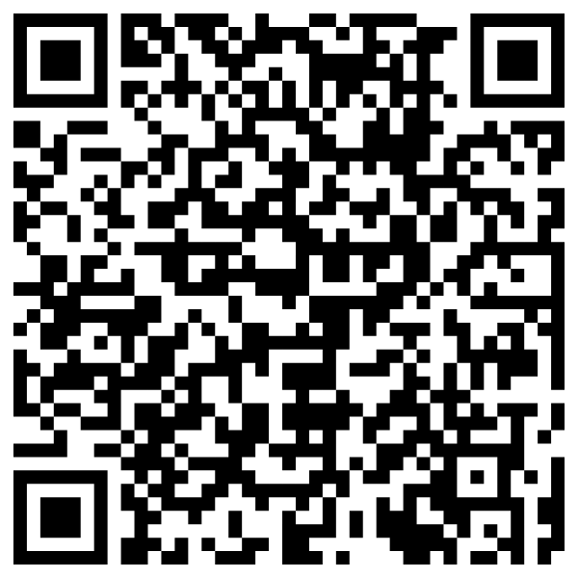

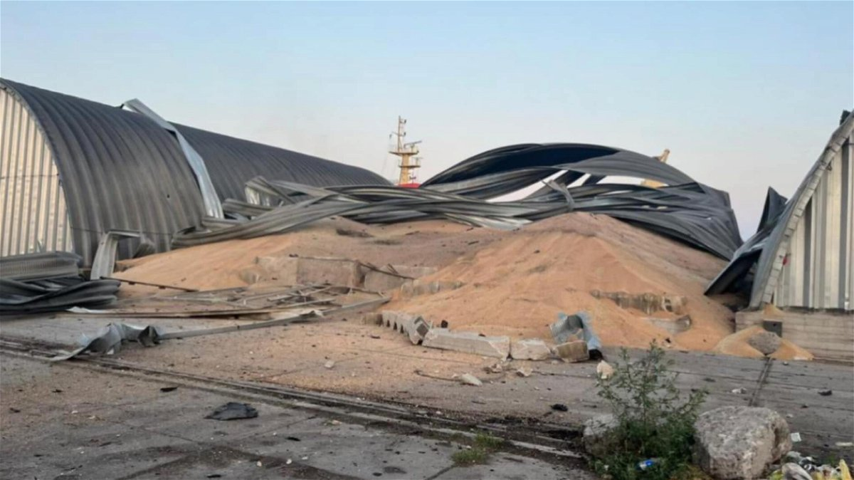
russia’s war crimes
2. Attacks against civilian objects
Deliberate attacks against civilian objects, including shelters
Deliberate bombing of energy infrastructure in cold season
Deliberate destruction of ports
and grain export facilities
05
Notes:
Since the beginning of February 2022 the Russians destroyed more than 120,000 civilian infrastructure facilities, including power plants, gas pipelines, schools, kindergartens, and numerous residential buildings all over the territory of Ukraine (https://war.ukraine.ua/russia-war-crimes/attacking-civilians-or-civilian-objects). Destruction of critical infrastructure objects, necessary for surviving of civilians, is a war crime.
One of the latest well known bloody attack was launched by Russia in Kramatorsk. On the evening of June 27, Russian troops shelled the city center of Kramatorsk in the Donetsk region with 2 Iskander missiles. As a result, a local cafe Rio was destroyed by an enemy missile hit. Nearby multi-storey buildings, commercial premises, vehicles, a post office, and other facilities were also affected by the explosion, with windows, glass, and doors shattered.
The bodies of 13 dead victims (including three children) have been recovered from the rubble. One of them was Ukrainian writer Viktoriia Amelina. Moreover, 60 people have been injured (including one child).
On 6 September 2023, a Russian missile hit a crowded market in the town of Kostyantynivka killing 17 and injuring 33 civilians. Except for stores, the explosion damaged electric power supply lines, an administrative building and a multi-storey building.
In 2023, the Russian Federation launched attacks against Ukrainian ports and grain infrastructure in order to prevent the export of Ukrainian grain to the international markets. Rockets and drones hit the ports of Odesa, Chornomorsk, Izmayil, Reni and others. Except for the attack against civilian objects itself, intentionally using starvation of civilians as a method of warfare, including by destruction of food supplies, is a war crime.

Slide 6
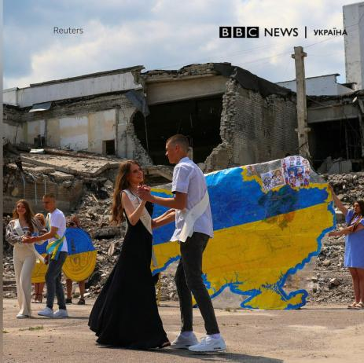
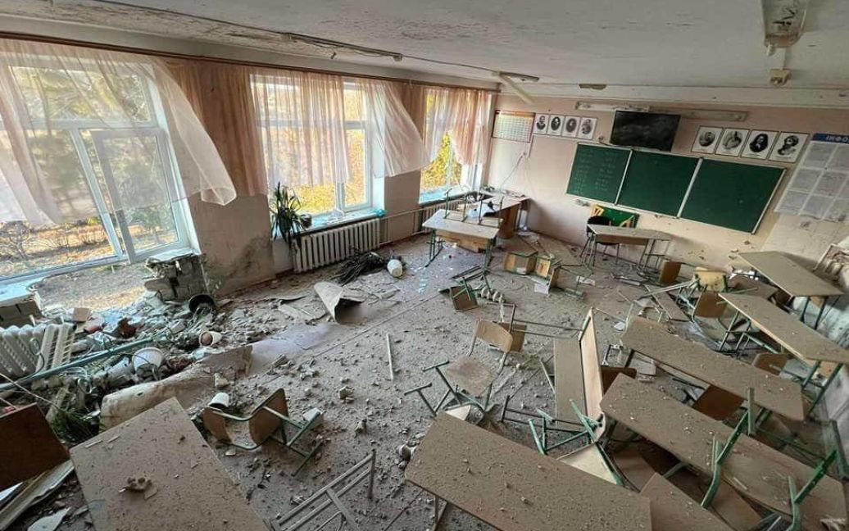
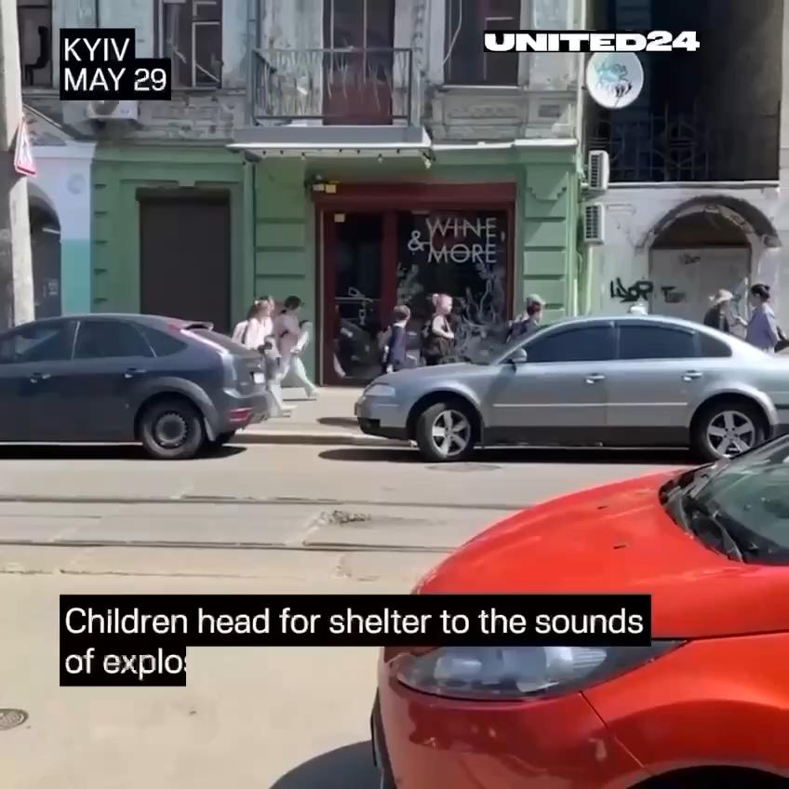
russia’s war crimes
2. Attacks against civilian objects. Schools
06
Notes:
As of February 24, 2023, at least 2,772 education institutions were partially damaged and more than 550 were destroyed, amounting to around 10 percent of all education institutions (across all levels of education) in Ukraine.
Сhildren are unable to study because of constant rocket attacks. As soon as the alert sounds, they leave the school and head for the bomb shelter. Sometimes they have only a few minutes to reach a safe place and run to the terrifying sounds of explosions.
Відео 2: Київ, 29 травня 2023 року

Slide 7
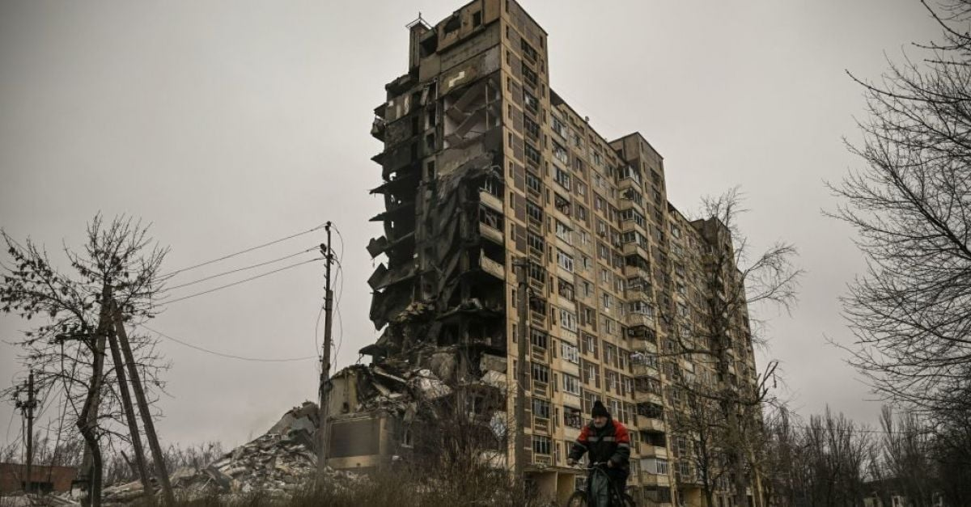
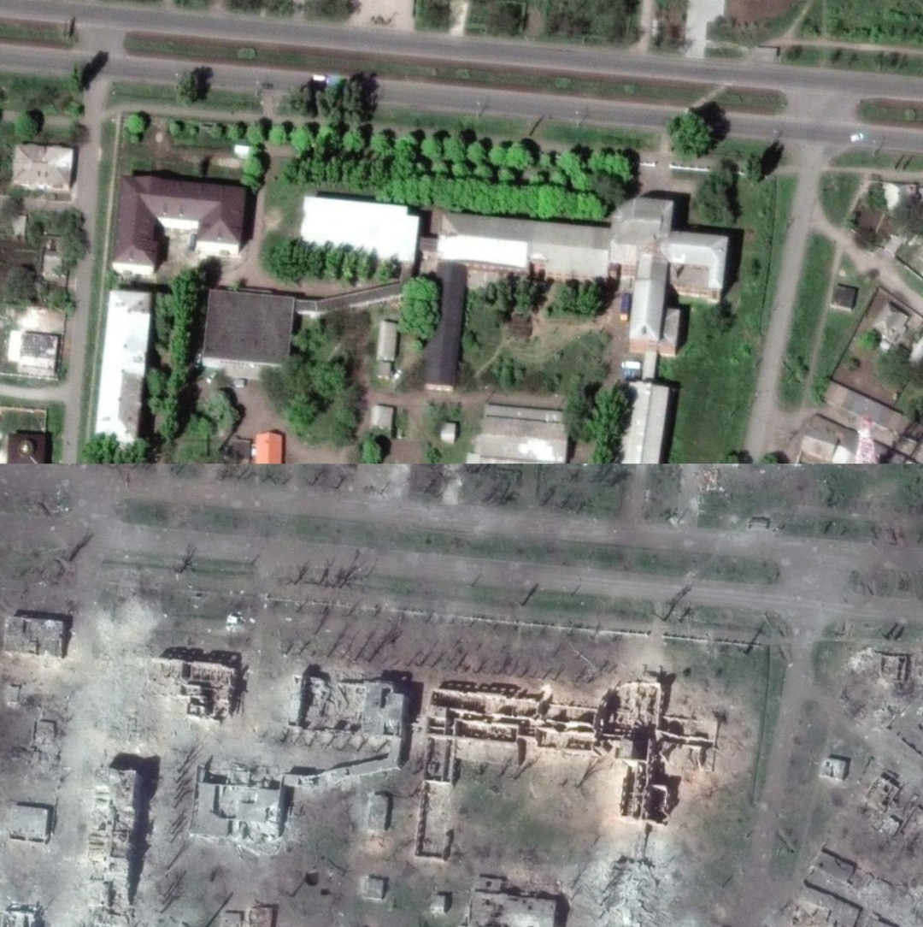
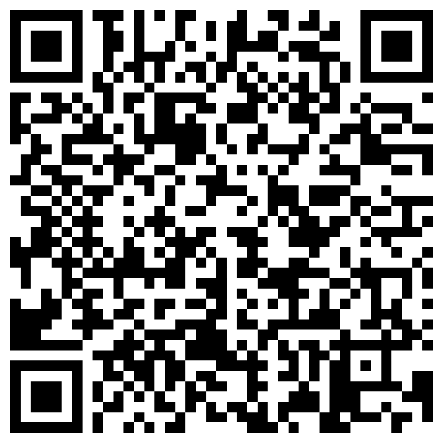
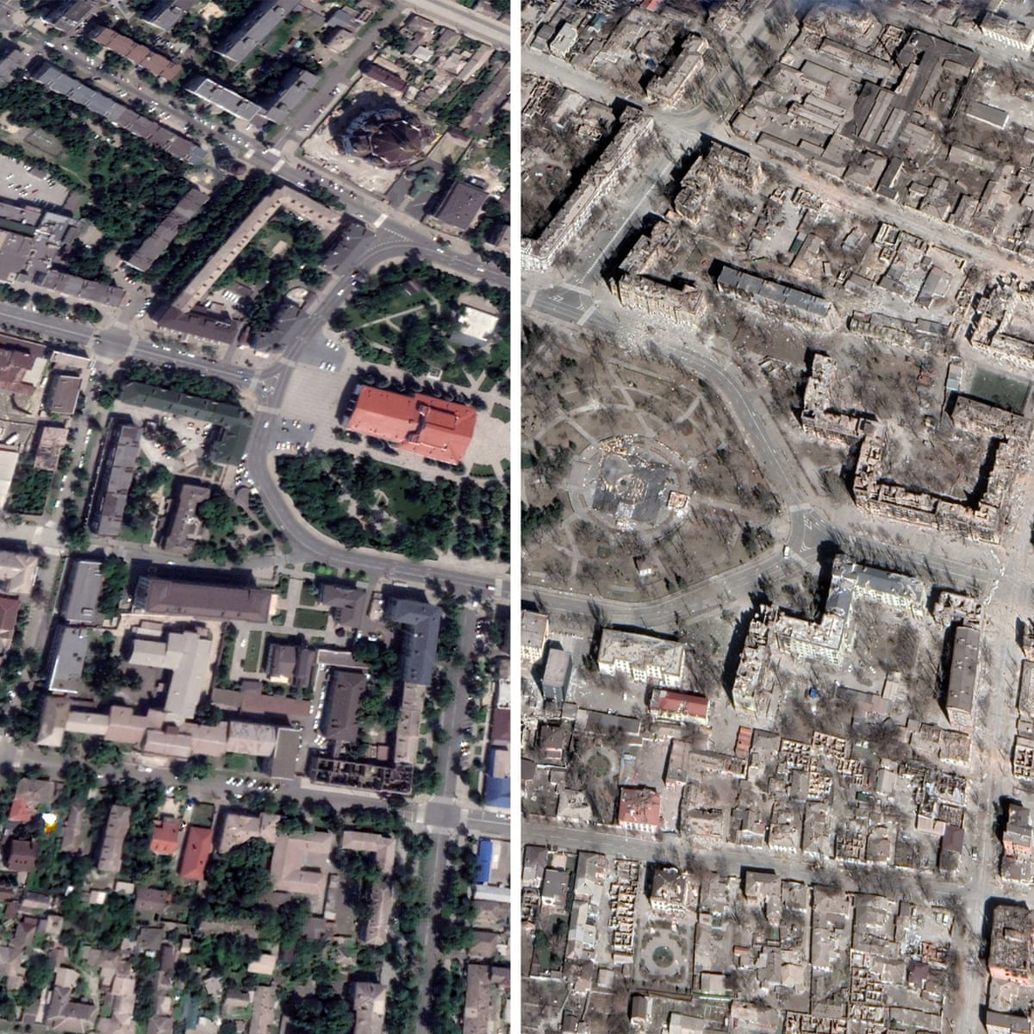
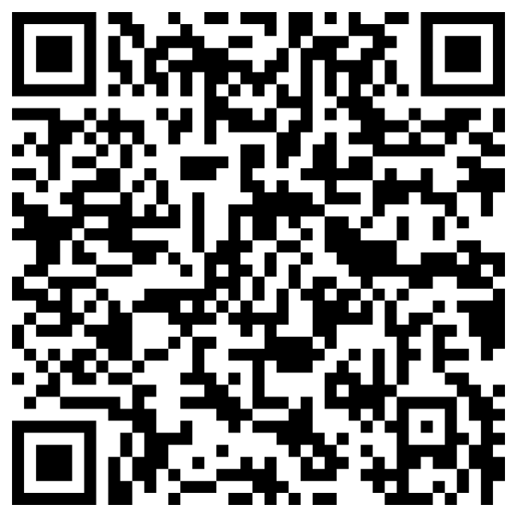
russia’s war crimes
2. Attacks against civilian objects.
Wanton destruction
Bakhmut before and after
Mariupol before and after
07
Notes:
Chaotic and systematic targeting of the civilian objects by the Russian Federation caused wanton destruction of cities, towns and villages.
Set of the Ukrainian cities and town are fully destroyed per now. No single civilian object is left without damages. Among those phantom towns and cities are Bakhmut, Mariupol, Volnovakha, Vugledar, Maryinka, Popasna, Soledar, Shchastya, Rubizhne. Mostly all of them are situated in the Donetsk region.

Slide 8
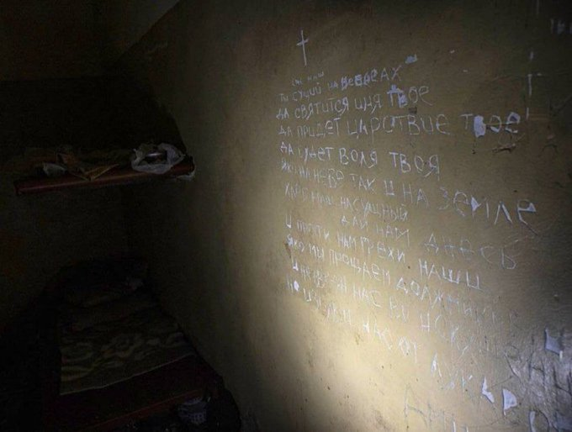
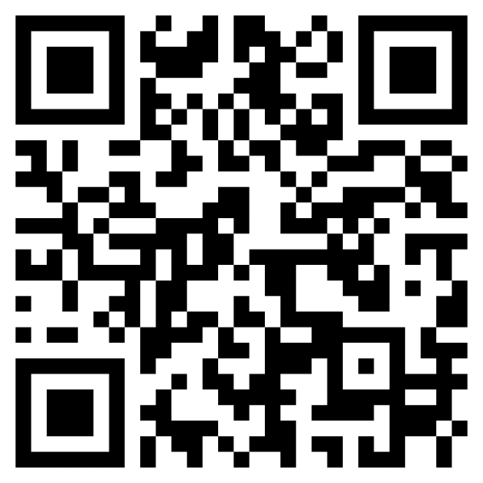
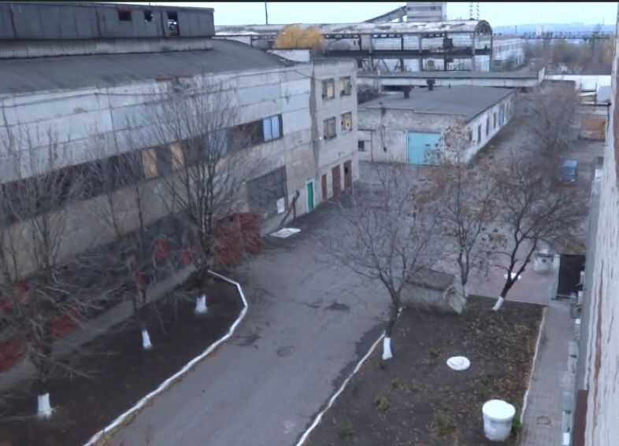

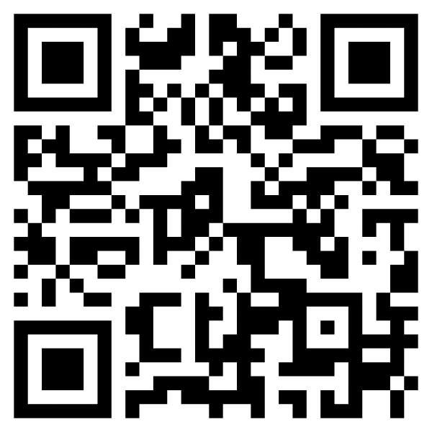
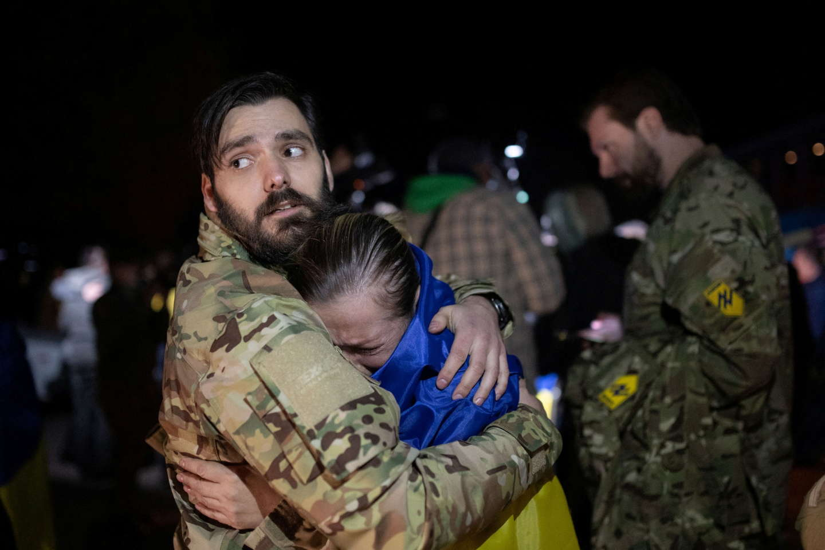
russia’s war crimes
3. Torture and other forms of inhuman treatment
Torture chambers are a
systematic practice in the
occupied territories.
The most notorious is the
so-called “Izolyatsia”
Almost all of liberated Ukrainian
POWs report being subjected
to torture or witnessing torture
08
Notes:
Russian military forces in Ukraine are consistently and intentionally inflicting severe physical and psychological pain and suffering on Ukrainian civilians and prisoners of war – The UN Special Rapporteur on Torture, Alice Jill Edwards, 15 Jun 2023 (https://www.ohchr.org/en/press-releases/2023/06/widespread-use-torture-russian-military-ukraine-appears-deliberate-un-expert#:~:text=Reports%20indicate%20that%20as%20a,impairment%20as%20well%20as%20motor)
This torture is allegedly being carried out to extract intelligence or to force confessions from detained individuals, or because of their former membership or support of the Ukrainian armed forces.
Reports indicate that as a result of torture, ill-treatment and poor conditions of detention many Ukrainian civilians and prisoners of war have suffered physical and psychological traumas, hallucinations, damage to internal organs, fractures and cracks in bones, extreme weight loss, sensory impairment as well as motor losses, strokes or the exacerbation of chronic diseases. Most individuals reportedly did not have access to adequate medical assistance during their detention.
1. 78 years old journalist Yevhen Bal died on April 2, 2022, in Melekino, near Mariupol.
According to the National Union of Journalists of Ukraine, on March 18, Russians detained Yevhen in his own home. The occupiers found several photos of the man with the Ukrainian military during the search, which led to further torture.
The Russians held Eugene captive for three days. He was released, severely beaten, and he died of his injuries.
Yevhen Bal was the author of journalistic publications about the war in Ukraine in the local press and a member of the National Union of Journalists of Ukraine. Yevhen also had the rank of captain in retirement; he served as a submariner.

Slide 9
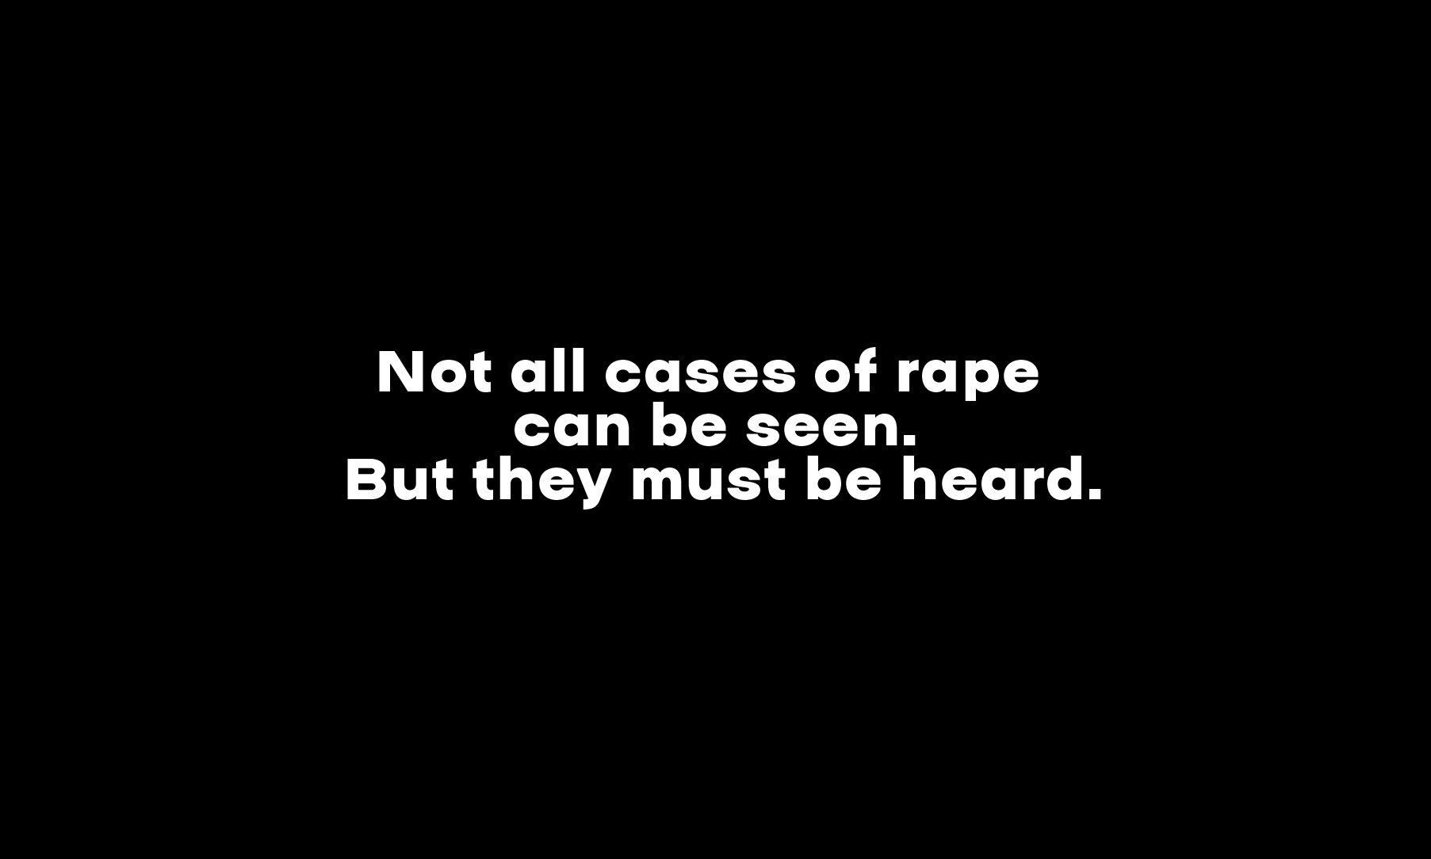
russia’s war crimes
4. Conflict-related sexual and gender-based violence
09
Notes:
As per 01 September 2023
Since the beginning of the full-scale military aggression of the Russian Federation, prosecutors have recorded 231 cases of CRSV (men - 82, women - 149, 13 of them are minors, including 12 girls and 1 boy (other type of sexual violence not related to rape), among them there are such types as rape, mutilation or violence to genitals, forced nudity, threats and attempts to rape, forcing to watch sexual abuse of a family member etc. Crimes were solved in 66 cases.
Currently, the highest number of cases of sexual violence has been recorded in Kherson region (69), Kyiv region (52), Donetsk region (55), Kharkiv region (21), Zaporizhzhia region (15), Chernihiv region (5), Luhansk region (3), and Mykolaiv region (9), Sumy region (2).
On the example of the Kherson region, prosecutors have recorded crimes of the russian military, such as rape and torture, as well as gender-based violence against mothers, wives, and sisters of the military of Armed Forces of Ukraine - all of these are nothing but patterns - weapons for the destruction of the Ukrainian nation (genocide).
In connection with sexual violence in the occupied territories of villages in Kyiv, Chernihiv, Kherson, Kharkiv and Mykolaiv regions, 34 Russian servicemen were notified of suspicion. Indictments against 17 people were sent to court, and two persons were sentenced to 12 and 10 years in prison.
Examples of recent reports of suspicion and sent indictments:
On August 30, 2023, an indictment was sent to the court against a 43-year-old colonel, commander of the 99th self-propelled artillery regiment of the 3rd motorized rifle division of the 20th combined army of the Western Military District of the Russian Armed Forces and two of his subordinates: a 20-year-old private, a driver, and a 24-year-old junior sergeant, the commander of a commando unit of the combat vehicle, which consisted in the rape of a local girl who was frightened and unable to resist, all four took turns raping the victim, having previously agreed on committing a crime
On August 31, 2023, a 24-year-old serviceman of the Russian Federation was notified of suspicion of the rape of two local residents of the Kherson region in the spring of 2022. In the evening, he came to the yard of the victims and took them with him, threatening them with weapons, forced them to drink alcohol against their will and raped them; one of the victims was a minor, whom he forcibly took away from her parents.
Examples of recently discovered facts:
- at the end of October 2022, in the territory of one of the occupied settlements of the Mykolaiv region, Russian servicemen came to a local 38-year-old resident for several days and sexually assaulted her, while threatening her husband with physical violence;
- in March 2022, on the territory of one of the occupied villages of the Kharkiv region, Russian military personnel threatened a 59-year-old local woman with a firearm and forcibly took her to a nearby village, where they held her in a cellar for two weeks, subjecting her to brutal treatment, including sexual violence.

Slide 10
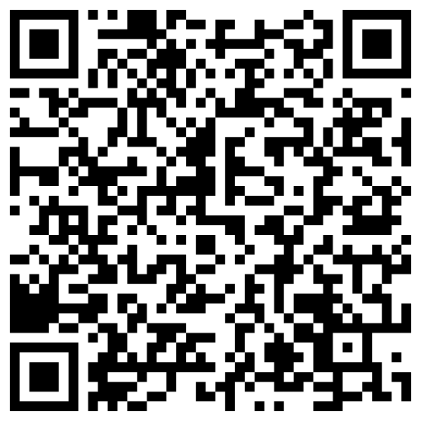
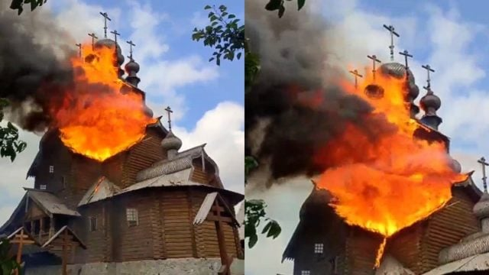

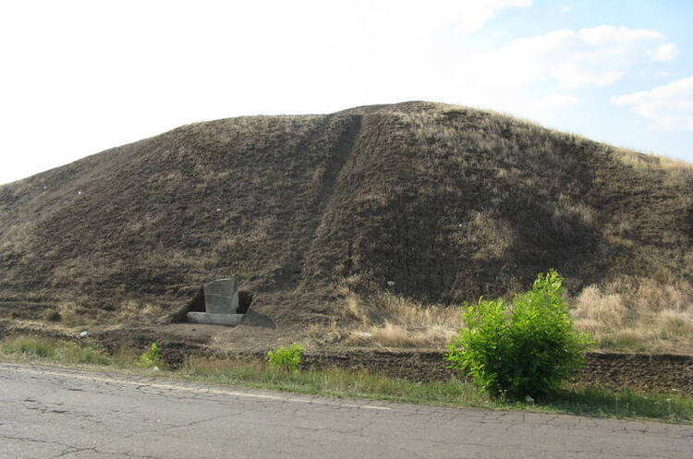

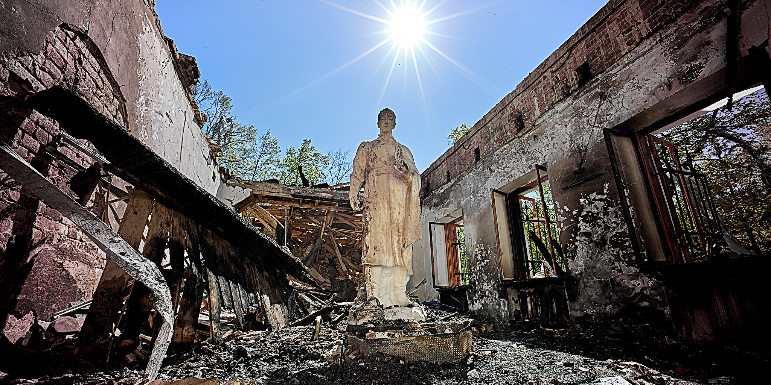
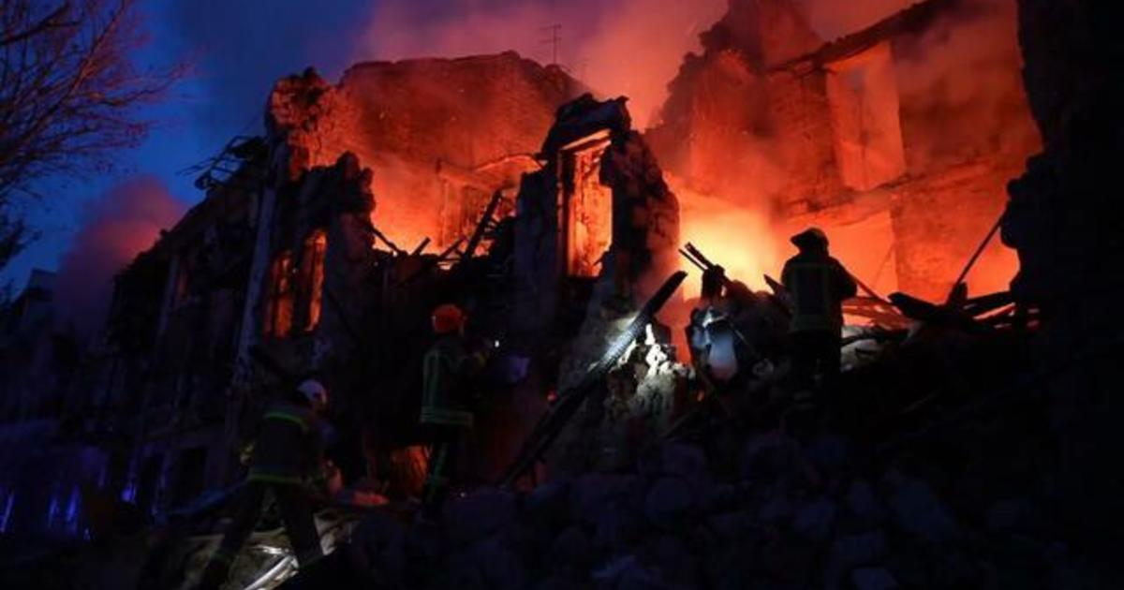
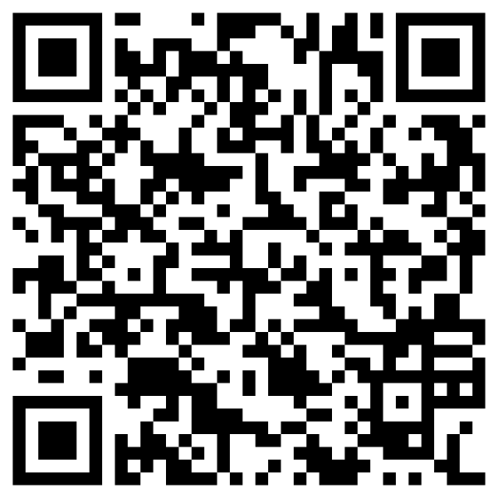
russia’s war crimes
5. Attacks against religion and culture
Temples of all religions and confessions under attack
Archeological sites turned
into battlegrounds
Museums destroyed, including
those of Hryhoriy Skovoroda
and Maryia Prymachenko
City centers shelled into
rubbles, including the UNESCO
world heritage sites
10
Notes:
Russian troops have committed more than 550 war crimes against cultural heritage sites in Ukraine.
This war was started not only to kill Ukrainians — Russia also set out to destroy Ukraine’s history and culture. Russians are destroying Ukraine’s museums, galleries, and churches to wipe out the Ukrainian nation and its unique, proud culture.
On 19 May 2022, the Church of the Holy Mother of God ‘Joy of All Who Sorrow’ in the village of Bohorodychne, the Donetsk region, was destroyed by Russian shelling.
On 25 February 2022, the Russian troops destroyed the museum of the Ukrainian naïve artist Maryia Prymachenko in the Kyiv region.
On 8 May 2022, the Russian shelling destroyed the museum of Hryhoriy Skovoroda in the Kharkiv region.
On 23 July 2023, the Russian missiles hit the downtown of Odesa, which is included into the UNESCO World Heritage list. 25 historical buildings were damaged, including critical damage to the Transfiguration Cathedral and the House of Scientists.

Slide 11
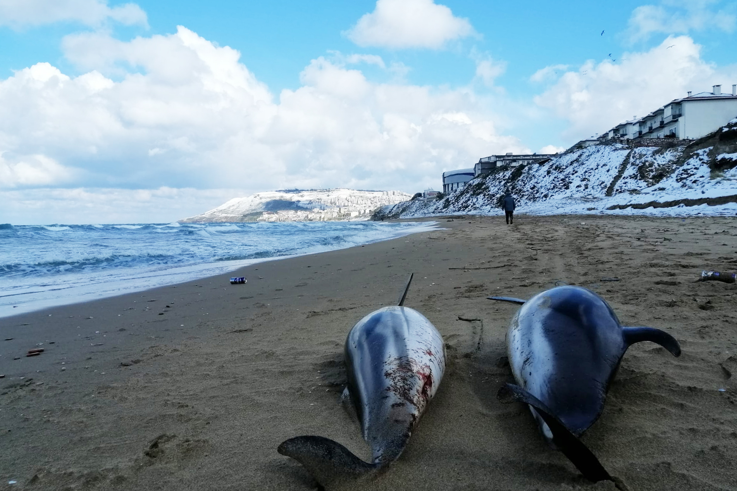
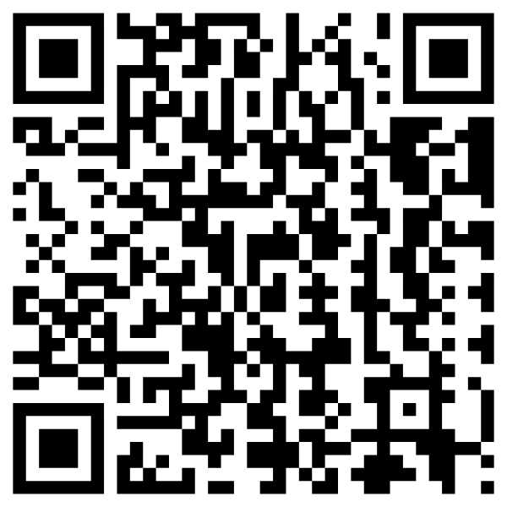
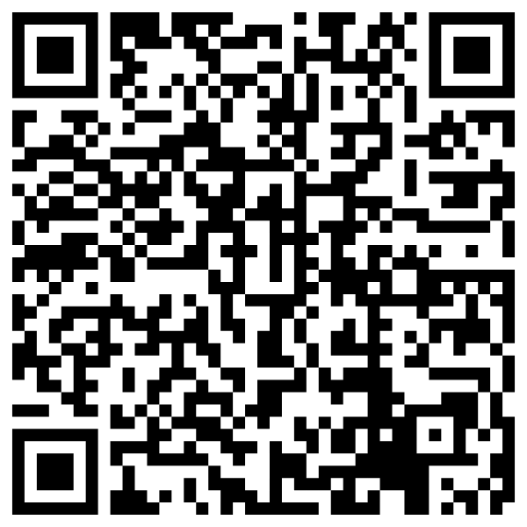
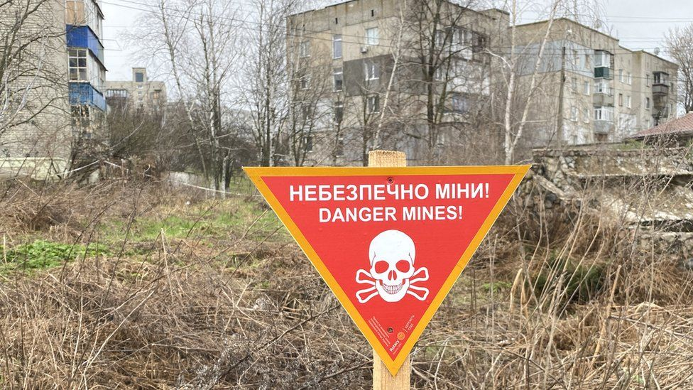

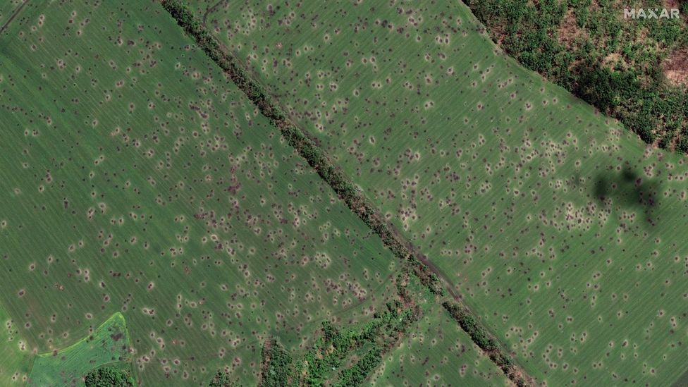
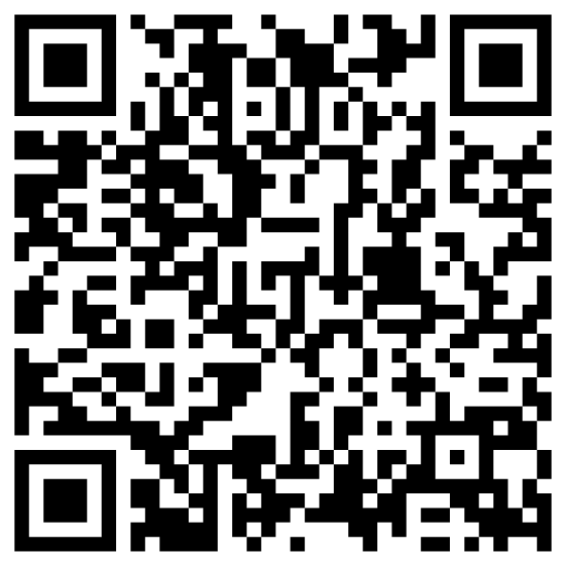
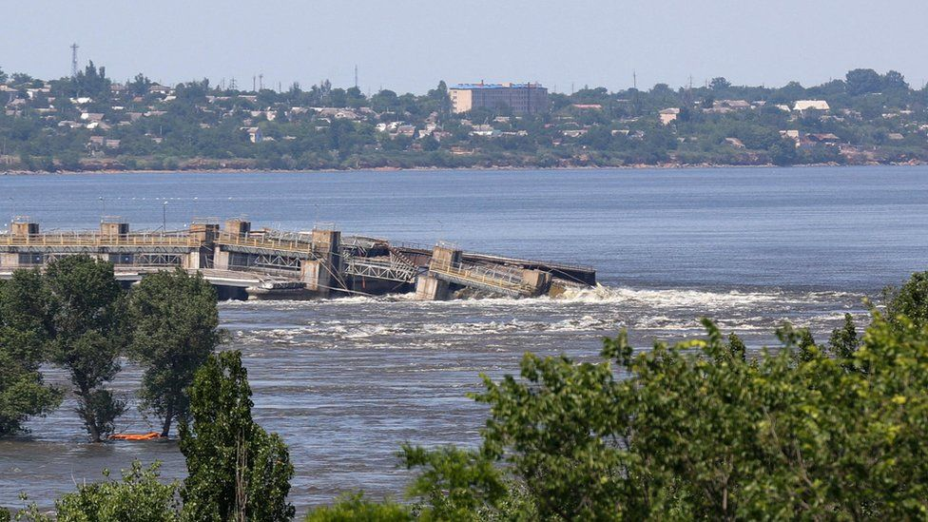
russia’s war crimes
6. Wanton destruction of natural environment
Marine mammals decimated
Debris of war contaminate
the soil, water and air
Huge areas rendered unlivable
because of fighting
The destruction of the Nova
Kakhovka dam entailed ecocide
11
Notes:
The russian troops committed around 200 crimes against the environment of Ukraine.
Not only cultural heritage of Ukraine, but also its unique nature is a victim of the war waged by Russia. The hostilities affected around one third of the territory of Ukraine, as well as its territorial waters and air space. Around 2,500 cases of damage to the environment have been recorded. The estimated damage amounts to around 50 billion dollars (20 billion to the soils, 25 billion to air, 1,5 billion to water).
Around 50 thousand dolphins and other marine mammals died in the Black and Azov Seas as a result of war. It will take decades to recover the population.
The total area of the mined territories is estimated to be around 180 thousand square kilometers making Ukraine the most mine-contaminated country in the world. Even more territory is contaminated with debris of munitions, fuel, metals, construction materials.
Territories affected by hostilities for a prolonged period of time become unlivable due to contamination with explosives and metal. They are similar to the Zone Rouge in France, where human habitation remains impossible even a 100 years after the war.
On the 6 of June 2023, the Russians blew up the Kakhovka HPP dam resulting in flooding of territories downstream and dewatering of territories upstream. Water level rose by 5 meters in the city of Kherson. Smaller towns like Oleshky and Hola Prystan have been flooded. 31 people and an enormous number of animals died. The Ukrainian Chief Prosecutor’s Office investigates this crime as ecocide.

Slide 12

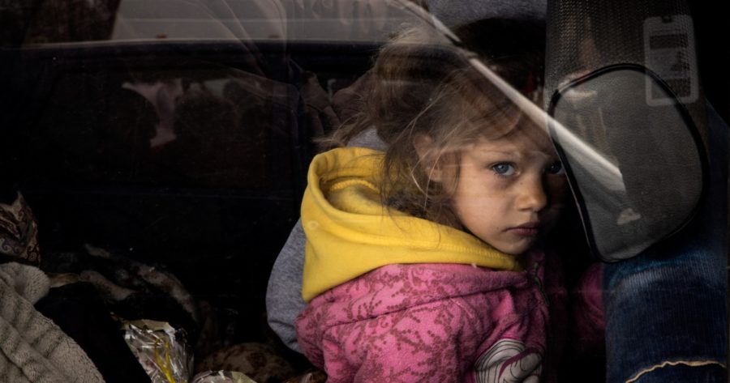
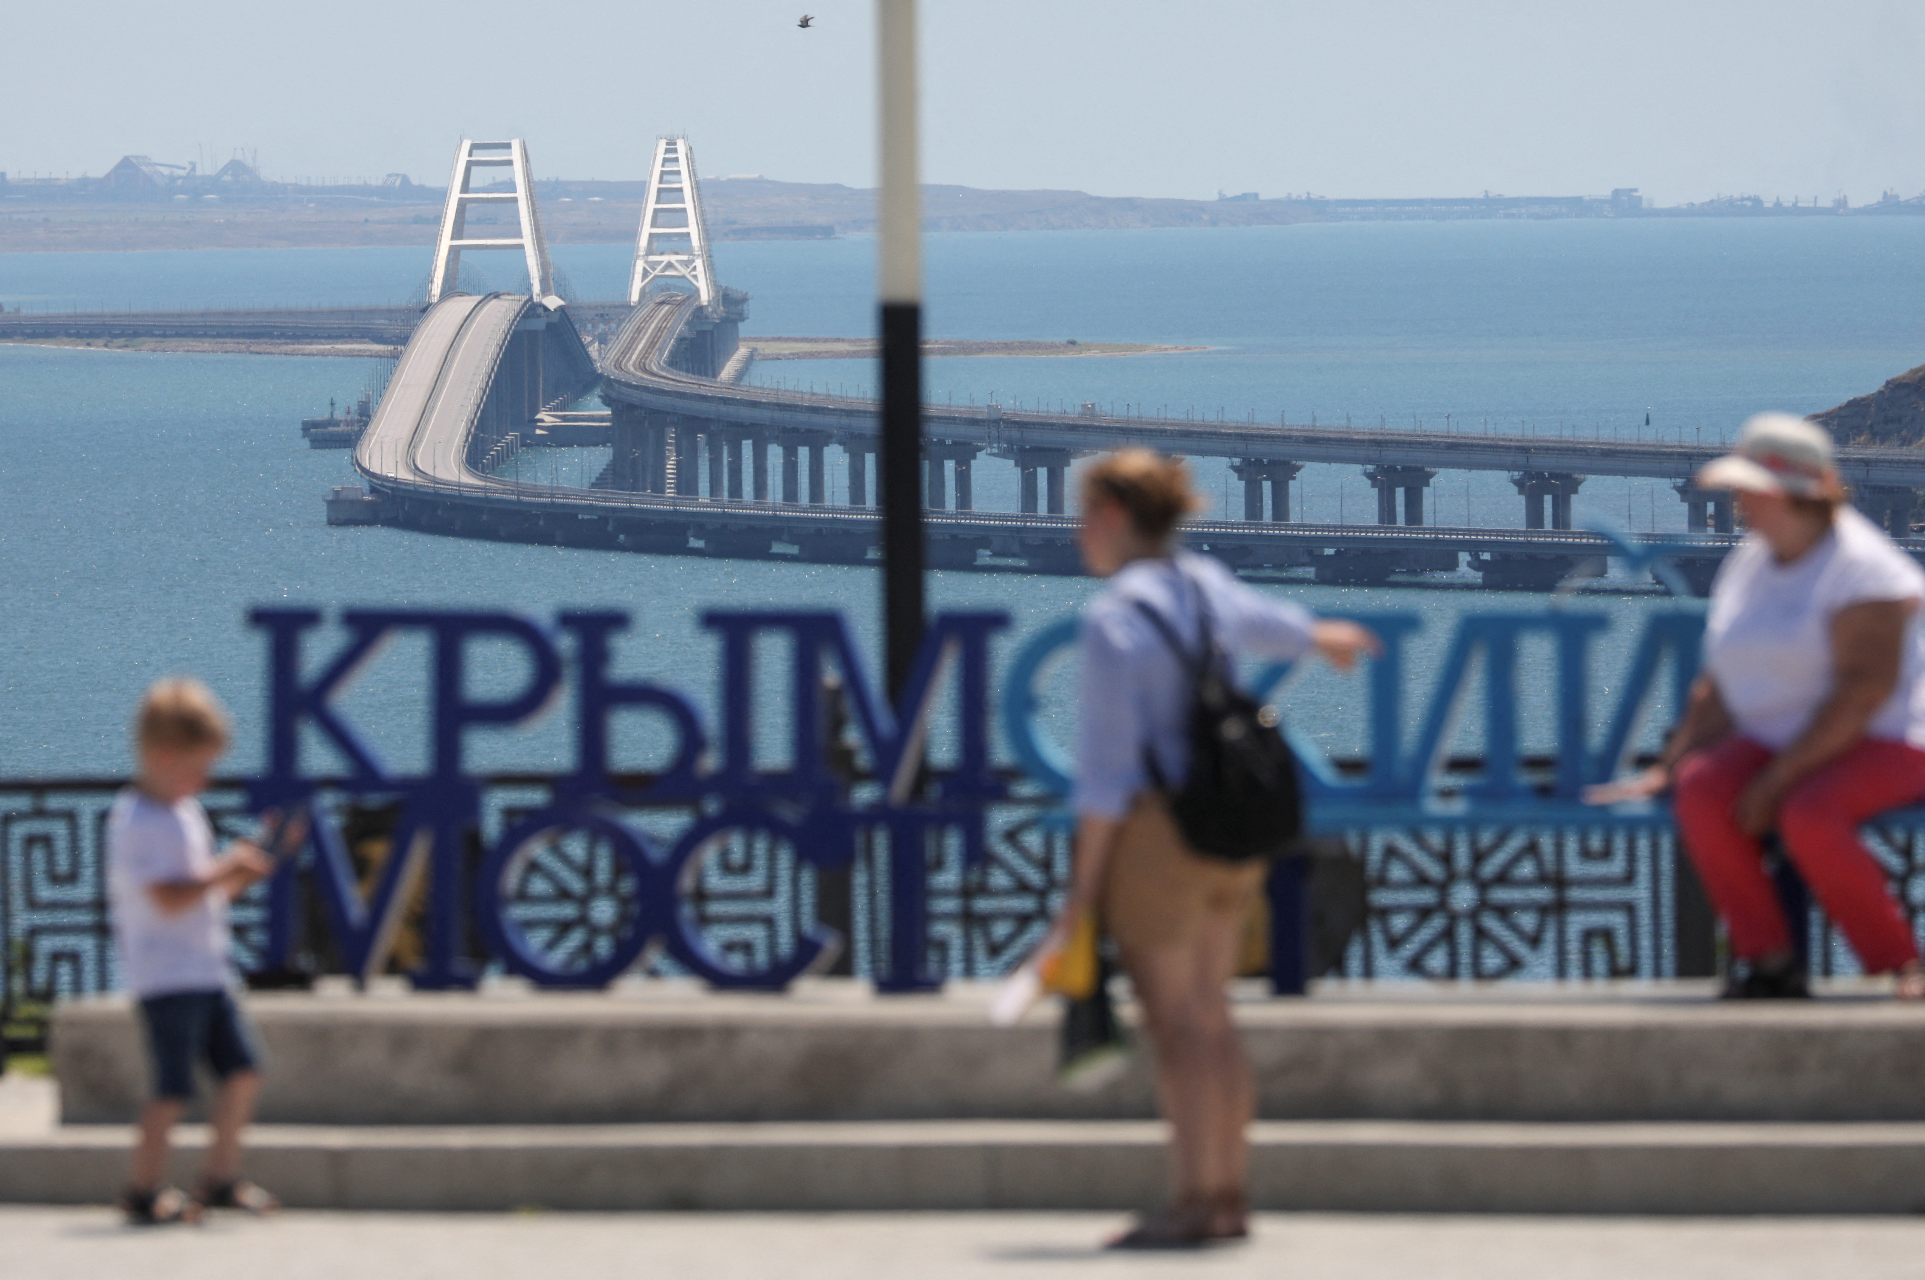
russia’s war crimes
7. Unlawful deportation
Over 16,000 children forcibly transferred to russia and belarus.
In In addition, russia forcibly transfers detainees and patients of various medical facilities
In addition, russia encourages migration of ethnic Russians to the occupied territories of Ukraine, thereby artificially changing the ethnic composition of the population
12
Notes:
The exact number of potential victims of deportation from Ukraine to russia is unknown, but it is estimated that anywhere between 2.8 to 5 million Ukrainians, including from 260,000 to 700,000 children.
It is impossible to assess these figures’ reliability and how many citizens were forced to leave under coercion, pressure, and intimidation. But it is evident that deportation is widespread within the overall russian attack on Ukraine.
Deportation under the guise of evacuation
The russian side frequently refers to it as the “evacuation of the civilian population” or the rescue of people, with propaganda channels showcasing videos of russians providing shelters to Ukrainian families fleeing the conflict.
However, there is abundant evidence that this is deportation, not a friendly evacuation. The reason behind this is the frequent use of coercion, restrictions on people’s decision-making, and obstruction of departure to prevent individuals from leaving Ukraine-controlled territories.
Such actions may be classified as war crimes under the Rome Statute of the International Criminal Court.
As a part of these crimes, Ukrainian citizens are systematically deported by the russians, with a system of temporary accommodation centers established within the territory of the russian federation and a corresponding filtration procedure implemented.
Moreover, russia adopted several legislative acts to implement this policy.
At the same time, the russian authorities encourages resettlement of russian nationals to the temporary occupied territories of Ukraine, including by granting them accommodation and jobs in the Donetsk, Luhansk, Zaporizhzhia and Kherson regions.

Slide 13
Russia’s war crimes
Among war crimes, broadly committed by Russian political and military leadership and soldiers, are:
- Attacks against civilian population
- Attacks against civilian objects
- Torture and other inhuman treatment
- Conflict-related sexual and gender-based violence
- Attacks against religion and culture
- Crimes against the environment
- Unlawful deportation
13
Notes:
Mentioned and briefly described above types of war crimes are only part of the general scope of war crimes, committed by the russian federation. Almost every Ukrainian family had lost someone or something because of the illegal acts of russian soldiers. All of them are seeking and definitely deserve justice. Therefore, a lot of work on brining perpetrators to individual criminal responsibility must be done.
Ukraine as a State uses different mechanisms and jurisdiction systems to perform this task. All of them could be divited in 2 large groups – national level and international level.

Slide 14
Investigations. NL
Актуальні дані та візуалізований матеріал до них щодня публікується на офіційних ресурсах Офісу Генерального прокурора, наприклад:
https://t.me/pgo_gov_ua
Пропонується інформацію на поточному слайді оновлювати для кожного заходу міжнародного співробітництва
14
Notes:
National law enforcement bodies and agencies are the main actors in brining war criminals to individual responsibility. Despite many initiatives on the international accountability mechanisms, Ukrainian law enforcement and judicial agencies perform majority of the work on documenting, investigating and prosecuting russian militaries, who committed war crimes.
Every day the Prosecutor General*s Office publishes updated information on the number of war crimes under the investigation. The latest information is presented on the slide.
As you see more than _________ war crimes are registered by law enforcement agencies. All of them are under investigation.
Experience of law enforcement agencies in investigating and prosecuting war crimes is quite unique due to several reasons.
Active investigations during the ongoing international armed conflict
Scope of the war crimes under the investigation
Scope of the law enforcement agencies involved in war crimes investigations
System of war crimes reporting, established after Feb 2022.
Thus, activities on investigating war crimes, committed by Russian militaries, are systematic and organized among different national bodies and agencies.
Ministry of Defense of Ukraine and the Armed Forces of Ukraine are among them.

Slide 15
Investigations. NL
Article 438 of the Criminal Code of Ukraine:
Cruel treatment of prisoners of war or civilians, deportation of civilian population to engage them in forced labour, pillage of national treasures on occupied territories, use of methods of the warfare prohibited by international instruments, or any other violations of rules of the warfare stipulated by international treaties, ratified by the Verkhovna Rada of Ukraine, and also issuing an order to commit any such actions
15
Notes:
Comparing to the ICC Rome Statute, the Criminal Code of Ukraine does not contain a list of war crimes. However, the Article 438 defines Violations of rules and customs of warfare as criminal offences. This Article is used by law enforcement agencies for qualification of breaches of IHL, committed by the russian forces.
Article 438 is an open one «and other violations of rules and customs of warfare, defined by international treaties that ratified by Ukraine», therefore provides broad possibilities to law enforcement agencies.
Ukrainian activities on investigating war crimes, committed by russian militaries, are systematic and organized within different national bodies and agencies.
Ministry of Defense of Ukraine and the Armed Forces of Ukraine are among them.

Slide 16
ROLE OF THE U MoD
Ukrainian MoD and the Armed Forces functions within the war crimes investigations:
Reporting cases of potential war crimes for further investigation
Providing information within the ongoing investigations of war crimes
Acting as specialists (experts) in the ongoing investigations of war crimes
Acting as members of the Interdepartmental Working Group on the Cooperation of Law Enforcement and Other State Bodies
16
Notes:
Neither MoD of Ukraine, no Armed Forces of Ukraine have the status of law enforcement agencies. Therefore, they are not empowered to investigate or prosecute war crimes. However, due to the peculiarities of the ongoing international armed conflict, Ukrainian MoD and Armed Forces of Ukraine play substantial role in brining war criminals to responsibility. On the one hand, in the combat area members of the Armed Forces of Ukraine are the only (or the first-hand)
victims | witness of the war crimes. On the other hand, very often members of the Armed Forces of Ukraine have unique knowledge and expertise necessary within the ongoing war crimes investigations.
Ukrainian MoD and the Armed Forces of Ukraine perform several functions, among which are:
Reporting cases of potential war crimes for further investigation
Providing information within the ongoing investigations of war crimes
Acting as specialists during the ongoing investigations of war crimes
Acting as members of the Interdepartmental Working Group on the Cooperation of Law Enforcement and Other State Bodies

Slide 17
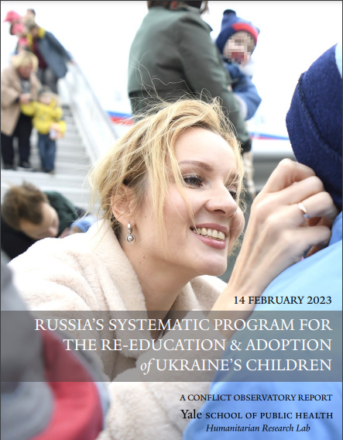
Investigations. IL
The International Criminal Court
2013, 2014 – declarations on
accepting the Court’s
jurisdiction over alleged
crimes
2023 – arrest warrants against
Putin and Lvova-Belova
Each suspect is accused
of war crime of unlawful
deportation of population
(children)
17
Notes:
Ukraine has been taking set of efforts to bring high political and military leadership of russia as well as other perpetrators to criminal responsibility on the international level.
The International Criminal Court (ICC)
Despite the fact, Ukraine is not a State Party to the Rome Statute, it has twice exercised its prerogatives to accept the Court's jurisdiction over alleged crimes under the Rome Statute occurring on its territory, pursuant to article 12(3) of the Statute. The first declaration lodged by the Government of Ukraine accepted ICC jurisdiction with respect to alleged crimes committed on Ukrainian territory from 21 November 2013 to 22 February 2014. The second declaration extended this time period on an open-ended basis to encompass ongoing alleged crimes committed throughout the territory of Ukraine from 20 February 2014 onwards.
On 17 March 2023, ICC Pre-Trial Chamber II issued warrants of arrest for two individuals in the context of the situation in Ukraine: Mr Vladimir Vladimirovich Putin, President of the Russian Federation, and Ms Maria Alekseyevna Lvova-Belova, Commissioner for Children’s Rights in the Office of the President of the Russian Federation. Based on the Prosecution’s applications of 22 February 2023, Pre-Trial Chamber II considered that there are reasonable grounds to believe that each suspect bears responsibility for the war crime of unlawful deportation of population (children) and that of unlawful transfer of population (children) from occupied areas of Ukraine to the Russian Federation, in prejudice of Ukrainian children.

Slide 18
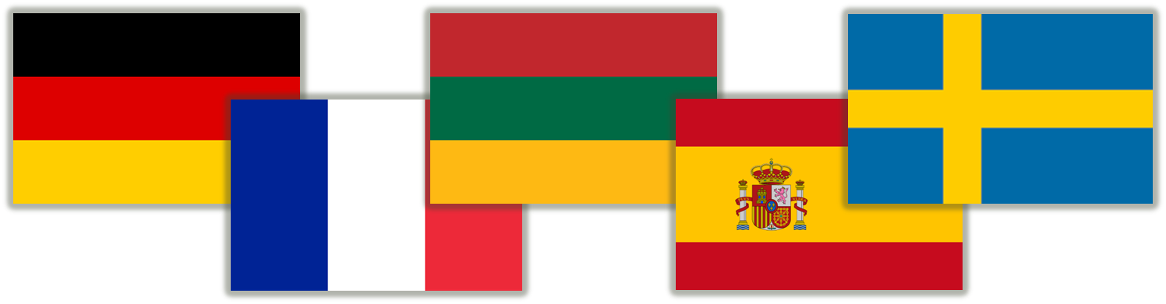
Investigations. IL
Universal Jurisdiction
As of 11 July 2022, Estonia, Germany, Latvia, Lithuania, Norway, Poland, Slovakia, Spain, Sweden, Switzerland and Romania had all declared their intentions of starting universal jurisdiction investigations of war crimes of the 2022 Russian invasion of Ukraine
18
Notes:
One more effort of Ukraine to bring war perpetrators to responsibility is international cooperation and universal jurisdiction.
Universal jurisdiction investigations of war crimes in Ukraine are investigations of war crimes in the 2022 Russian invasion of Ukraine carried out under the legal systems of individual states under the universal jurisdiction principle of international humanitarian law. Several states had started investigations.
For instance, Estonia, Germany, Latvia, Lithuania, Norway, Poland, Slovakia, Spain, Sweden, Switzerland and Romania had all declared their intentions of starting universal jurisdiction investigations of war crimes of the 2022 Russian invasion of Ukraine.

Slide 19
Investigations. IL
Instead of conclusions
The scope of the war crimes, committed by the russian federation and its agents during the invasion of Ukraine is broad (all over the territory of Ukraine, detachments of the Armed Forces of russia)
Russia has been committing almost all war crimes types
The complex system of brining perpetrators to accountability is established on national and international levels
Ukrainian experience of investigating war crimes during the ongoing conflict is quite unique
The Ukrainian MoD and the Armed Forces play substantial role in the system of brining war criminal to accountability
19
Notes:
On behalf of the Ukrainian MoD and State generally, we call you to take all visible measures to end war crimes committed by the russian federation and to bring war criminals, including high military and political leadership of russia, to individual criminal responsibility.

Slide 20
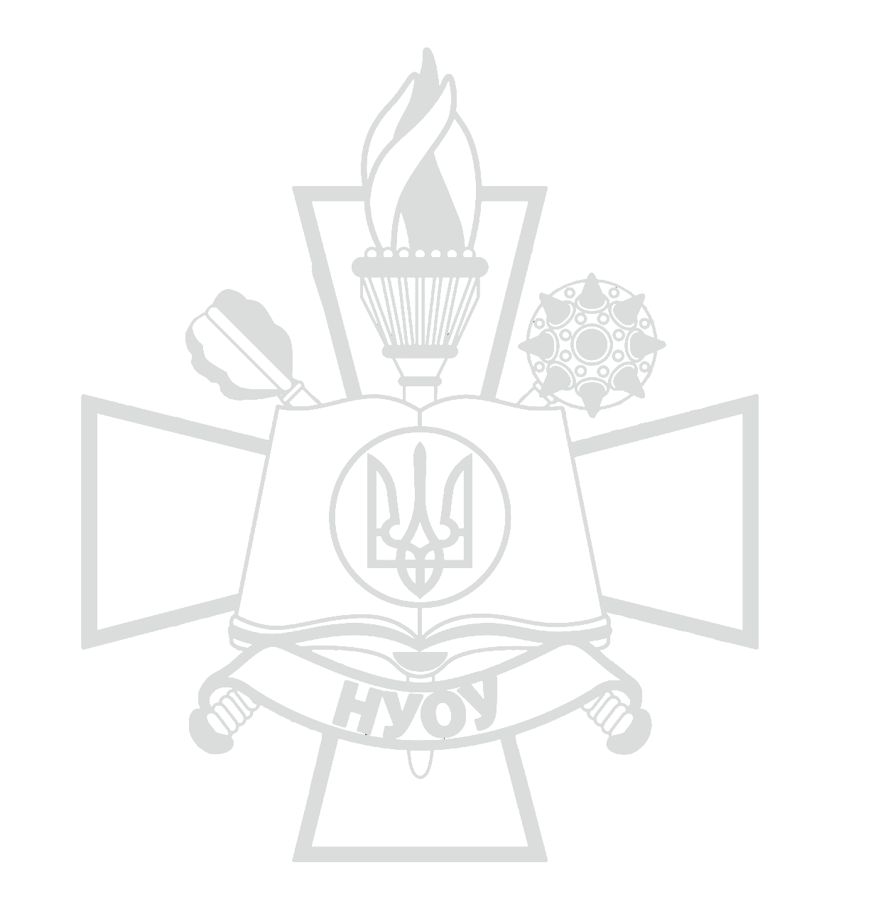
Thank you for attention!
Q and A

